Slide 1
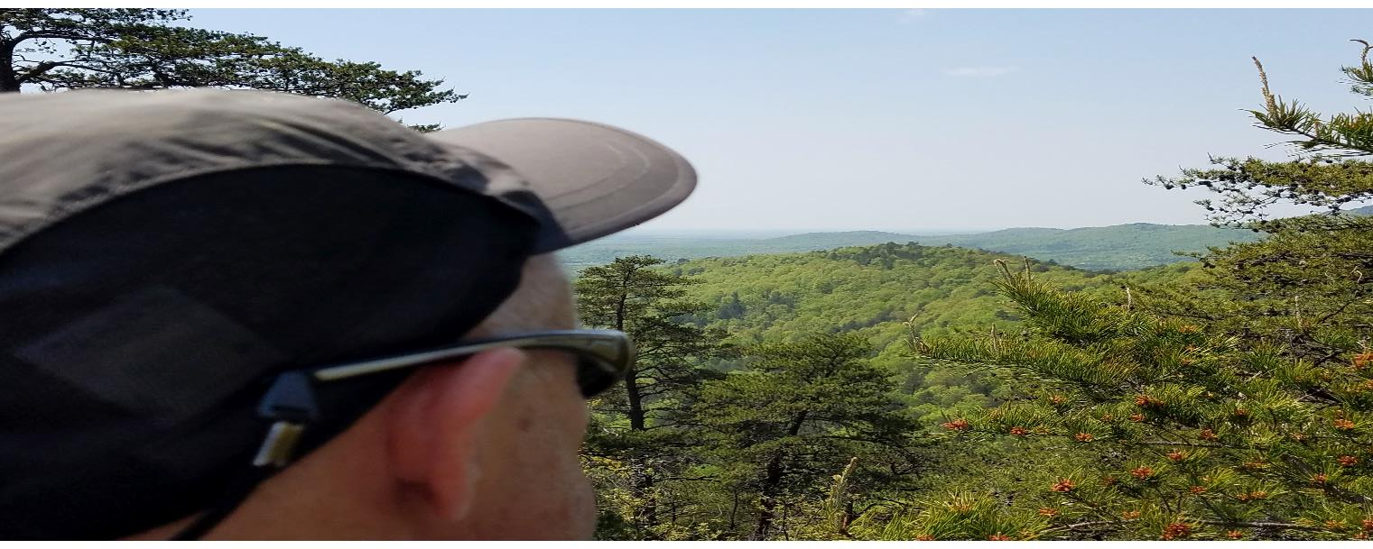
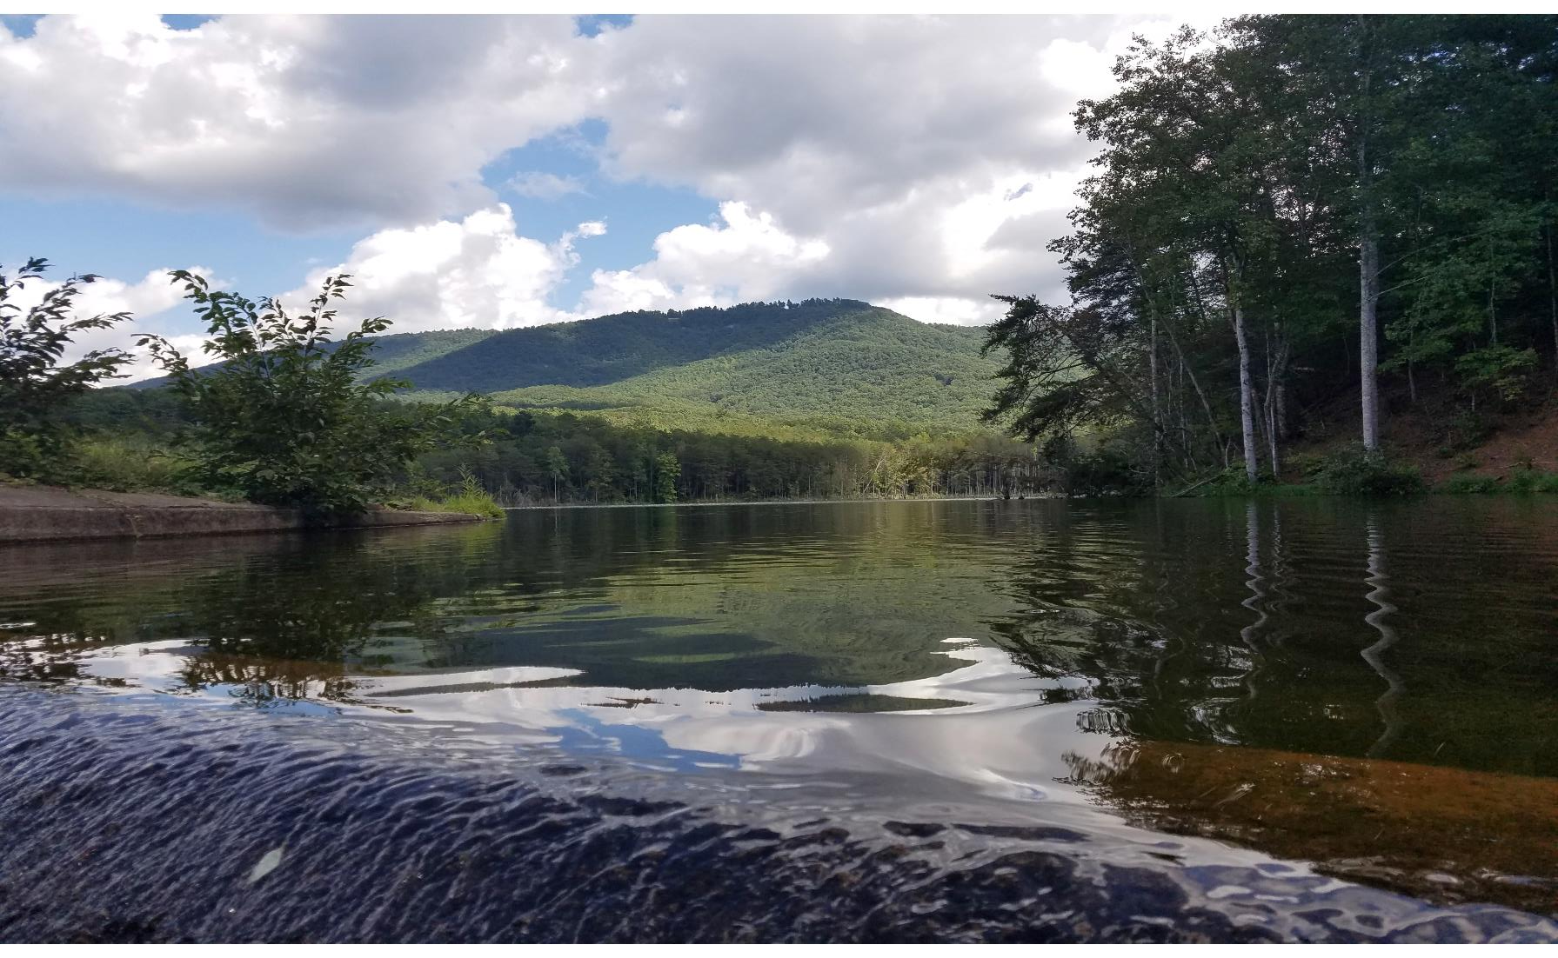
Where Do We Go
For Intimate Prayer?

Slide 2
Psalm 121:1 I lift up my eyes to the mountains—where does my help come from?
2 My help comes from the Lord, the Maker of heaven and earth.

Slide 3
Does prayer come to you easier in a setting
such as this more than in church?

Slide 4
What is your attitude when you pray on a mountain top?

Slide 5
The Temple Court

Slide 6
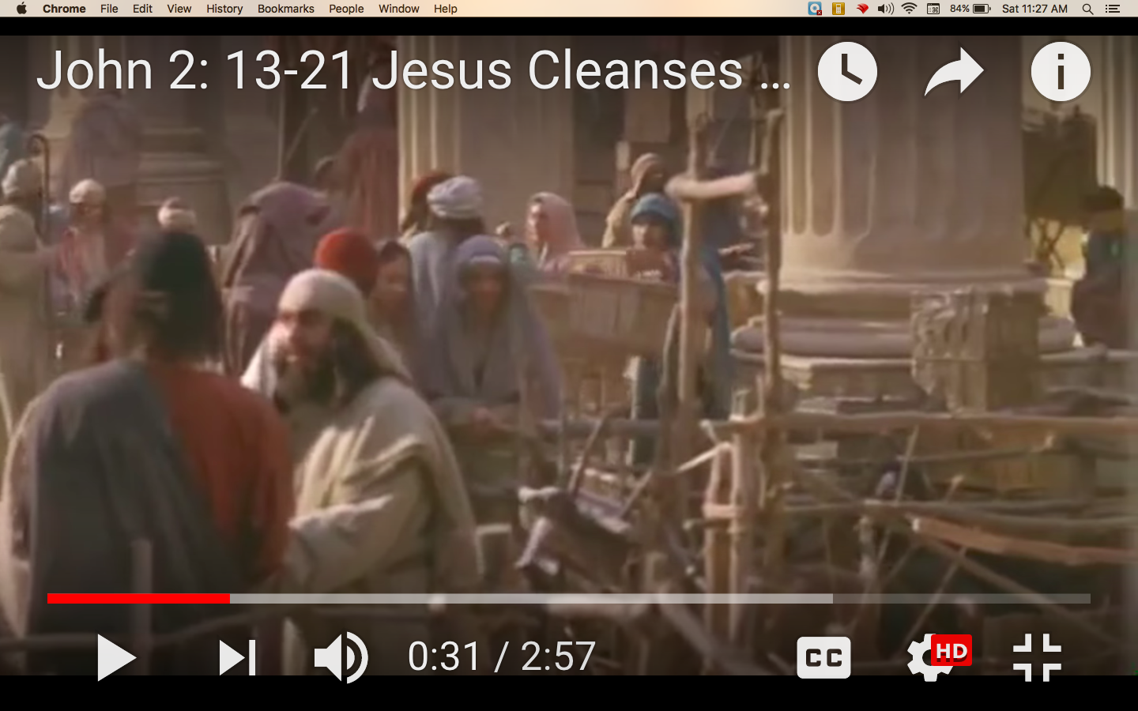
Mark 11:17 - And as he taught them, he said, “Is it not written: ‘My house will be called a house of prayer for all nations’? But you have made it ‘a den of robbers.’ ”

Slide 7
First of all…
How does this scripture contrast with the worship on the mountaintop we have mentioned today?

Slide 8
The “temple area” is also known as the court of the Gentiles, and
was the only part of the temple where the Jews allowed the Gentiles to worship God and gather in prayer.. Mark also notes that the temple courts were
being used as a shortcut between the Jerusalem city market and Mount of Olives to
the east.
If you were a gentile in that time who wanted to worship our true God, how would you be made to feel in the temple?
Why do you think that the Jews were fine with “buying and selling” in the “temple area”?
What does it tell you about the Gentiles that did come to worship?

Slide 9
Now let’s look at the make-up of the temple.

Slide 10
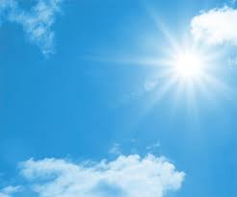
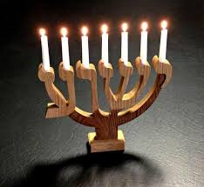
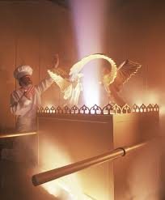
Can you compare these different
lights to the different aspects of
prayer?
Light was an important part of the make-up of the temple. First there was natural light. Then came light designed by man in the Menorah as a representation of praise and honor. Finally, the light in the Holy of Holies where the Arc of the Covenant was placed came from God Himself!

Slide 11
Only the high priest who had been sanctified could visit the Holy of Holies.
Think of what happened during the crucifixion.
How are we able to enter into the Holy of Holies? https://www.gotquestions.org/temple-veil-torn.html
The Holy of Holies was where one found the essence of God, His abode.
According to Jesus where does God Abide?
John 14:23
Jesus answered him,
"If anyone loves me, he will keep my word.
Then my Father will love him,
and we will go to him and
make our home within him.

Slide 12
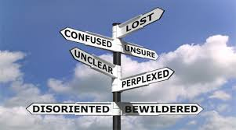
Knowing this, where do we go to have the most intimate prayer?

Slide 13
Let’s look again at the essence of prayer.

Slide 14
Now let’s have our prayer time as a class as each of us visits the Holy of Holies. We will end with the song on the next page.

Slide 15
click
The Name of Jesus

